Slide 1
Ethylene Tetramerization: Mechanism and Role of Solvent
Sibo Lin, Yagnaseni Ghosh, Brian Hanna, dana wong, Mohamed Elanany, Motaz Khawaji, Wei Xu

Slide 2
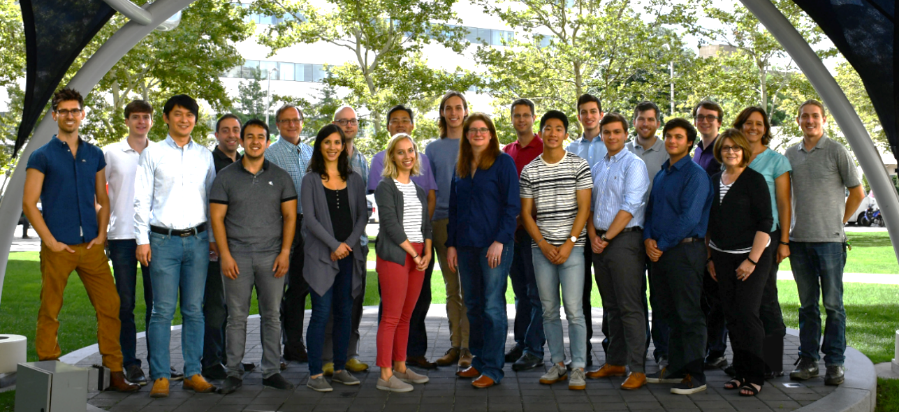
acknowledgements
Aramco Americas
Advanced Materials Team (Cambridge, MA)
Jenna C. Fromer
Yagnaseni Ghosh
Brian Hanna
Douglas Theberge
Dana A. Wong
Atieh Abu Raqabah
Saudi Aramco Chemicals R&D
Mohamed Elanany
Wei Xu
Motaz Khawaji
King Fahd Univ. of Petroleum and Minerals
E. A. Jaseer
Samir Barman

Slide 3
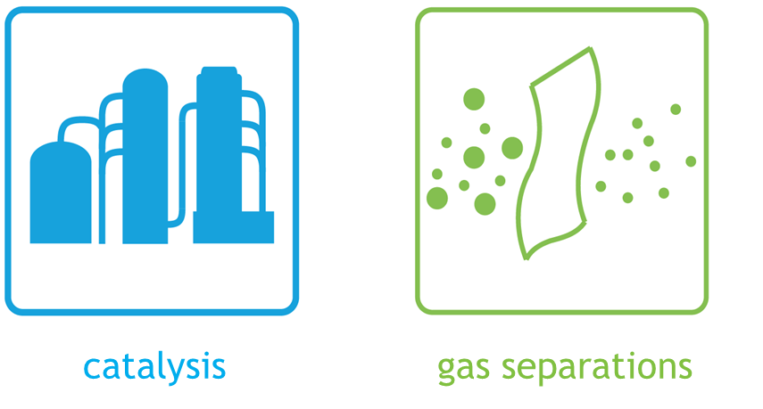

Boston downstream research center
mission: accelerate downstream innovations through development and optimization of advanced materials

Slide 4
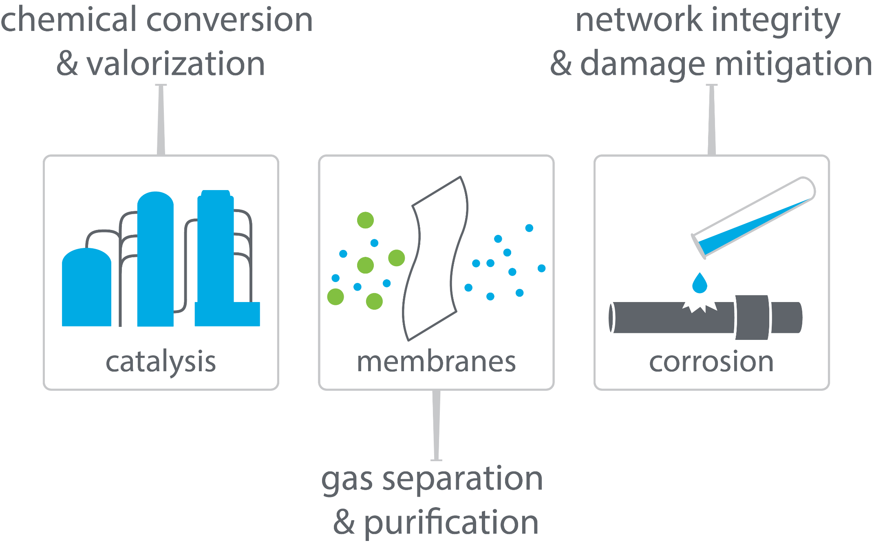
boston downstream research center

Slide 5

linear α-olefins for LLDPE
polyethylene plant
LLDPE
1-butene
ethylene
1-hexene
1-butene
1-hexene
polymer quality increases
1-octene
1-octene
highest quality plastic

Slide 6
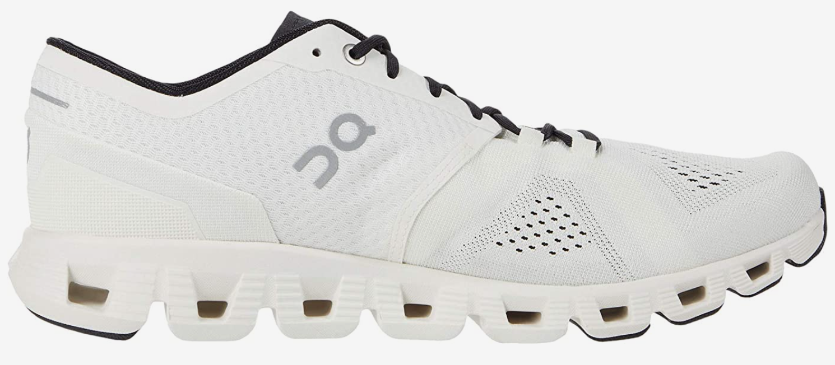
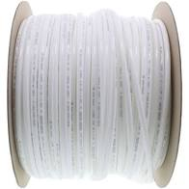
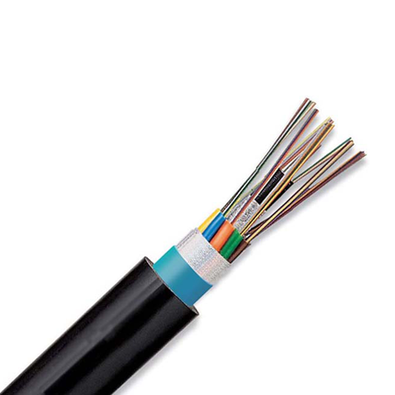
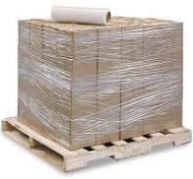
LLDPE
tough
flexible and food-safe
1-butene
stretchable
electrical and chemical safety
1-hexene
1-octene
Notes:
Image credits:
https://www.uline.com/Product/Detail/S-12827/Uline-Stretch-Wrap/Economy-Stretch-Wrap-Cast-80-gauge-18-x-1500
https://www.freshwatersystems.com/products/3-8-od-lldpe-polyethylene-tubing-500-ft-roll
https://www.hillnmarkes.com/
http://www.blspolymers.com/LLDPE.htm

Slide 7
α-olefins from full-range ethylene oligomerization
How to make 1-octene selectively?
undesired products
1-butene
1-hexene
existing commercialized full range technologies:
Shell Higher Olefin Process (SHOP)
Chevron Phillips full-range process
INEOS process
1-octene
Nexant report - Developments in LAO Comonomer for Polyethylene - PERP 2012S11

Slide 8
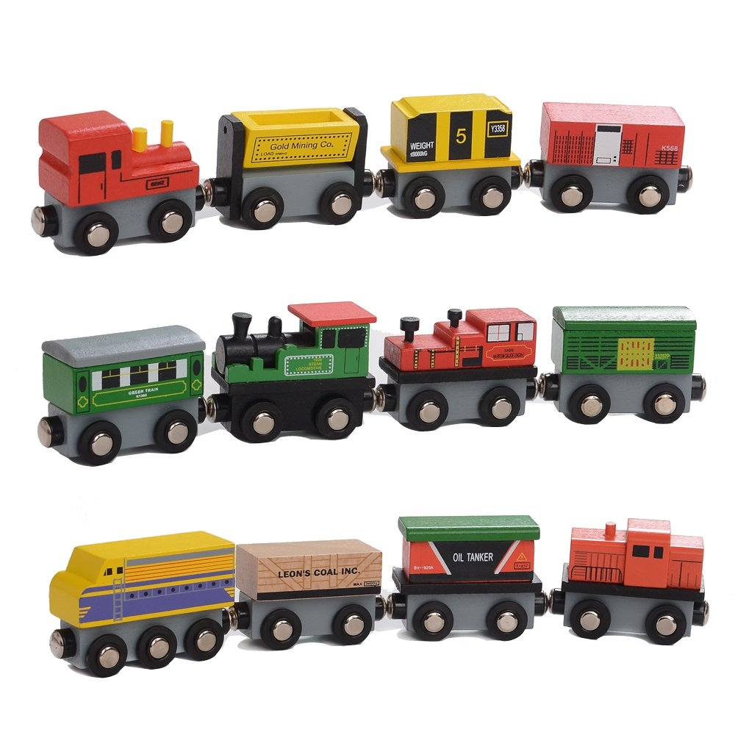
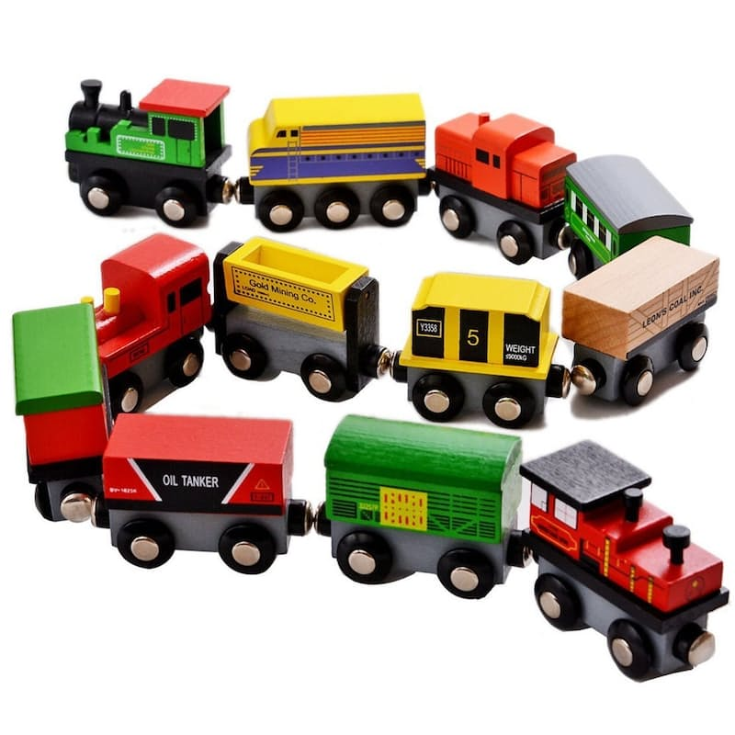

polymerization vs selective tetramerization
catalyst

Slide 9
selective ethylene tetramerization (and residual polymerization)
Sasol’s catalyst
Solvent Effects
Observations
Haloarene solvents greatly increase activity
Chloroarene solvents reduce 1-C₈ selectivity
Haloarene solvents reduce polymer fouling
Hypothesis
Haloarene solvents play an inner-sphere role in activity, 1-C₈ selectivity, or PE
solvent | productivity (g/gCr/h) | 1-C₈ / 1-C₆ (molar) | PE (wt%)
n-C₁₂H₂₆ | < 133 | ca. 1.50 _ | > 50
PhH | 1538 | 1.14 | 2%
PhMe | 827 | 1.25 | 6%
PhCl | 11744 | 0.44 | 0%
PhF | 13513 | 1.10 | 0%
o-DCB | 6803 | 0.67 | 1%
o-DFB | 11987 | 1.24 | 0%
Activity (kg/g Cr/h) | 1-C₈ (wt%) | 1-C₆ (wt%) | PE (wt%)
272.4 | 67 | 12 | 1
Bollman et al, J. Am. Chem. Soc. 2004, 126, 14712
Elowe, P. R., Caltech Ph.D. Thesis, 2008
Elowe, P. R.; Bercaw, J. E. "Solvent, additive and co-catalyst effects for ethylene oligomerization catalysis." 2009, WIPO, WO2009046144A1
Confidential

Slide 10
prior DFT mechanism study
Observations
Simpler ligand used (N-Me instead of N-iPr)
Only explored a few conformers:
7 for ethylene adduct (18b)
3 for ethylene insertion TS (TS18f-19)
1 for beta hydride trainsfer TS (TS8-12)
Predicted too high 1-C₈/1-C₆ ratio (ΔΔG = 5.7 kcal/mol)
Strategy
Analyze the full ligand (N-iPr)
More exhaustively search molecular conformations
Britovsek, G. J. P.; McGuinness, D. S. Chem. Eur. J. 2016, 22, 16891

Slide 11
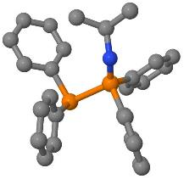
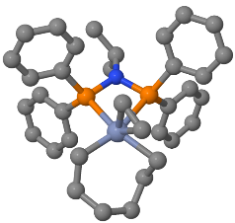
Computational: Automated Conformational Analysis (XTBDFT)
autoConf
Automated multi-level conformational search
Built on 3 open-source engines:
GFN-xTB/CREST
NWChem
GoodVibes
Simplified user input
Lightweight (for facile installation on internet-restricted compute clusters)
input geometry
(and charge and spin)
final structure and energy
XTBDFT
single-ended reaction coordinate scan
(GFN-xTB)
conformer ensemble generation & ranking
(CREST and GFN-xTB)
ensemble refinement (NWChem)
minimum final optimization (NWChem)
quasi-harmonic frequency corrections
(Goodvibes)
input reactant geometry
specify reaction coordinate
(and charge and spin)
final TS structure and energy
How many conformers within 6 kcal/mol window?
autoTS
Lin, S.; Fromer, J. C.; Ghosh, Y.; Hanna, B.; Elanany, M.; Xu, W. Sci. Rep. 2021, 11, 4534
Lin, S.; Elanany, M.; Khawaji, M. SoftwareX 2022, in revisions; Preprint available: https://ssrn.com/abstract=4155262
Code and Tutorials at: https://github.com/sibo/xtbdft

Slide 12
XTBDFT case study: ethylene insertion transition state
nohup xtbdft.py start.xyz -chrg 1 -uhf 3 -mode autoTS 28 65 1.6 -other=”-cbonds 1.0” &
“nohup” and “&” to run job in background
“-chrg” and “–uhf” to denote charge and unpaired electrons
“-mode” set to autoTS
Reaction coordinate:
Distance between atoms 28 & 65, from 3.06 to 1.60 Å
constrains all bonds with harmonic potential to prevent Cr-P dissociation
(1.0 Hartree/Bohr² force constant)
Lin, S.; Fromer, J. C.; Ghosh, Y.; Hanna, B.; Elanany, M.; Xu, W. Sci. Rep. 2021, 11, 4534
Lin, S.; Elanany, M.; Khawaji, M. SoftwareX 2022, in revisions; Preprint available: https://ssrn.com/abstract=4155262
Code and Tutorials at: https://github.com/sibo/xtbdft

Slide 13
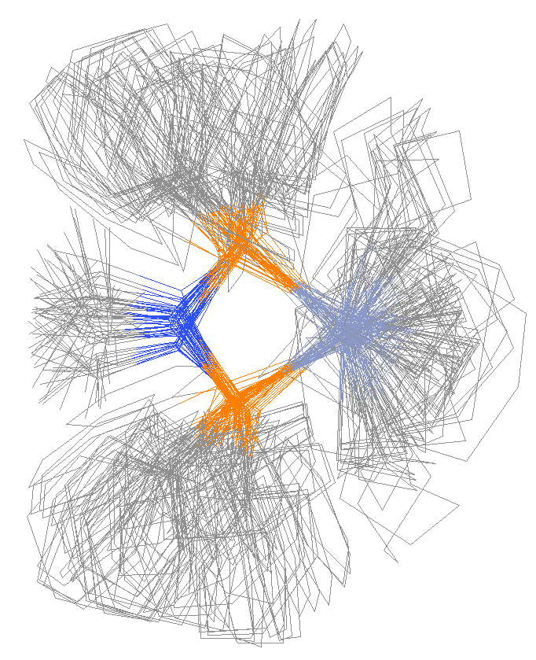
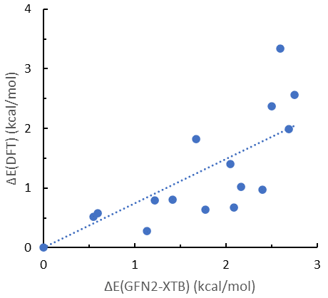
case study: ethylene insertion transition state
a
b
c
reaction coordinate scan
GFN2-XTB can help screen the lowest energy conformers
reaction path finder
constrained conformer search
69 conformers within 6 kcal/mol window
Lowest energy conformer found by XTBDFT is 1.1 kcal/mol lower than that found by McGuinness

Slide 14
rate-limiting steps that determine catalyst activity
toward
1-hexene product
toward
C₁₀₊ products
toward
1-octene product
turnover-limiting barriers
Computational details: NWChem 6.8, M06-D3/def2-TZVP//B3LYP-D3/def2-SVP + solvation energy (M06-D3/def2-SVP)

Slide 15
no inner-sphere effect of PhX on catalyst activity
third ethylene or PhX ligand does NOT assist the rate determining step
(kcal/mol)
Greater catalyst activity in PhX solvent may be simply due to better solubility of cationic catalysts
Computational details: NWChem 6.8, M06-D3/def2-TZVP//B3LYP-D3/def2-SVP + solvation energy (M06-D3/def2-SVP)

Slide 16
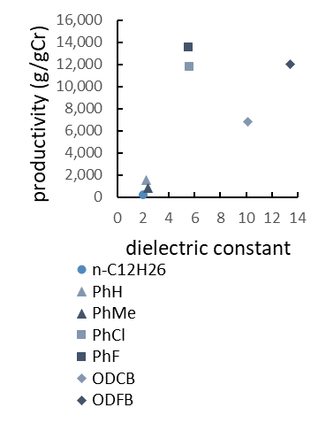
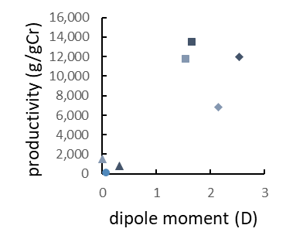
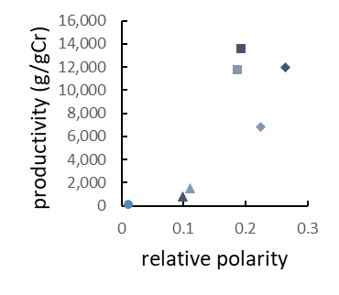
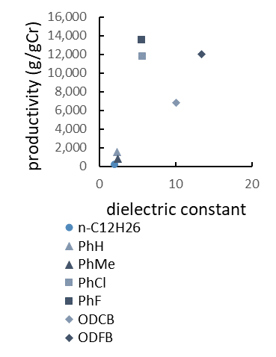
correlation between solvent polarity vs activity
(a)
(b)
(c)
solvent dielectric constant, dipole moment, and relative polarity do are correlated with catalyst activity
…but do not explain the underperformance of ortho-dihaloarene solvents

Slide 17
1-C₈ vs 1-C₆ determining steps
toward
1-hexene product
toward
C₁₀₊ products
ethylene ligand assists BHT
toward
1-octene product
turnover-limiting barriers
product-determining barrier
ΔΔG(1-hexene/1-octene) = 3.1 – 0.6 = 2.5
Computational details: NWChem 6.8, M06-D3/def2-TZVP//B3LYP-D3/def2-SVP + solvation energy (M06-D3/def2-SVP)

Slide 18
PhX does not bind to resting state
toward
1-hexene product
toward
C₁₀₊ products
toward
1-octene product
turnover-limiting barriers
Computational details: NWChem 6.8, M06-D3/def2-TZVP//B3LYP-D3/def2-SVP + solvation energy (M06-D3/def2-SVP)

Slide 19
inner-sphere effect of PhX on 1-C₈/1-C₆ selectivity
Β-hydride transfer TS
(toward 1-hexene)
ethylene insertion TS
(toward 1-octene)
polymer chain termination
Correctly predicts that PhCl solvent lowers 1-C₈/1-C₆
Correctly predicts that PhF solvent retains 1-C₈/1-C₆
Shows that haloarene solvents can act as chain-terminating agents (for some unknown polymerization species)
ΔG (kcal/mol)
Computational details: NWChem 6.8, M06-D3/def2-TZVP//B3LYP-D3/def2-SVP + solvation energy (M06-D3/def2-SVP)

Slide 20
summary
Automated conformational TS search with XTBDFT is powerful and easy to run
Catalyst activity not increased by inner-sphere PhX, but correlated with bulk solvent polarity
PhCl reduces 1-C₈ selectivity through inner-sphere coordination, while PhF does not
Haloarene solvents can act as chain-terminating agents (for unknown Cr polymerization species)

Slide 21
thank you for your attention

Slide 22
Supporting Information

Slide 24
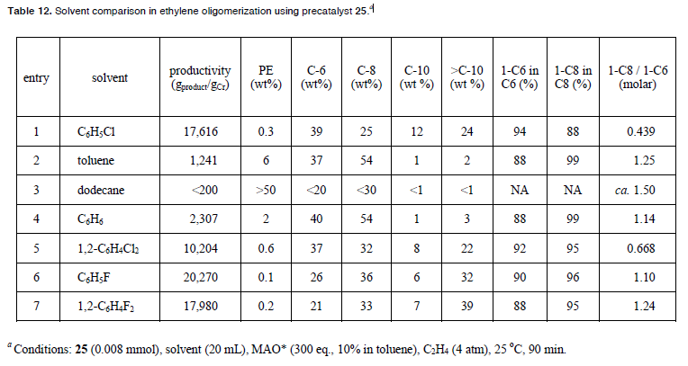
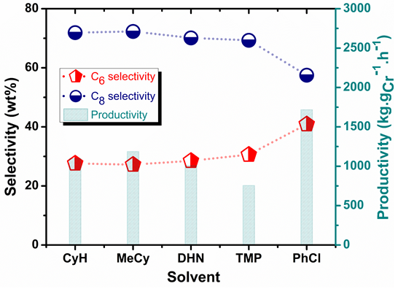
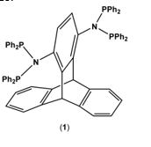
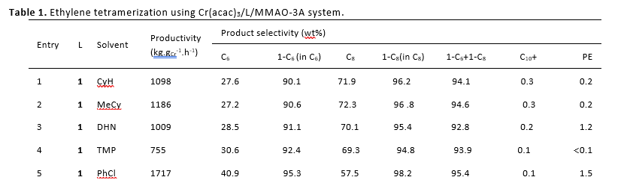
empirical effect of PhX on ethylene oligomerization
Results with a Cr-PNP catalyst being developed at KFUPM (Samir Barman and E. A. Jaseer)
Paul R. Elowe, Caltech Ph.D. Thesis, 2008
PhX solvent increase catalyst productivity
PhX lowers PEwt% relative to PhMe and PhH
PhCl lowers C8/C6 ratio
PhF preserves C8/C6 ratio
Elowe, P. R.; Bercaw, J. E. "Solvent, additive and co-catalyst effects for ethylene oligomerization catalysis." 2009, WIPO, WO2009046144A1.

Slide 25
prior DFT mechanism study
Observations
Simpler ligand used (N-Me instead of N-iPr)
Only explored 7 conformers of ethylene adduct (18b) and 1 conformer of ethylene insertion TS (TS18f-19)
Predicted too high 1-C₈/1-C₆ ratio (ΔΔG = 5.7 kcal/mol)
Britovsek, G. J. P.; McGuinness, D. S. Chem. Eur. J. 2016, 22, 16891

Slide 26
reaction pathway for full Sasol ligand, no additives
toward
1-hexene product
toward
C₁₀₊ products
turnover-limiting barriers
product-determining barriers
ΔΔG(1-hexene/1-octene) = 3.1 – 0.6 = 2.5
ΔΔG(1-octene/C₁₀₊) = -5.1 – 2.3 = -7.4
toward
1-octene product
Computational details: NWChem 6.8, M06-D3/def2-TZVP//B3LYP-D3/def2-SVP + solvation energy (M06-D3/def2-SVP)

Slide 27
inner-sphere effect of PhX on 1-C₈/1-C₆ selectivity
ΔG in kcal/mol, including continuum solvent corrections
w/o explicit PhX
explicit PhCl solvent:
explicit PhF solvent:
Correctly predicts lower 1-C₈/1-C₆ with PhCl solvent than PhH
Correctly predicts same 1-C₈/1-C₆ with PhF and PhH solvents
Supports that haloarene solvents can act as chain-terminating agents, reducing polyethylene wt%
ΔΔG: 1.4 0.2 1.4
Computational details: NWChem 6.8, M06-D3/def2-TZVP//B3LYP-D3/def2-SVP + solvation energy (M06-D3/def2-SVP)

Slide 28
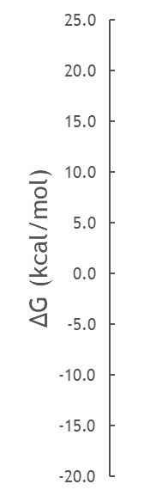
reaction pathways with PhX solvents
L =
(PhCl)
(PhF)
(none)
L =
(PhF)
(PhCl)
(none)
(PhF)
(C₂H₄)
(PhCl)
(none)
toward
1-hexene
L =
(PhF)
(C₂H₄)
(PhCl)
(none)
toward C₁₀₊
toward C₈₊
Still need to model
Barrier toward cyclic C6 products
Other secondary ligands (o-dihalobenzene)
Other ligands (N-(m-CF₃-C₆H₄) for KFUPM?)
toward
1-octene
Computational details: NWChem 6.8, M06-D3/def2-TZVP//B3LYP-D3/def2-SVP + solvation energy (M06-D3/def2-SVP)

Slide 29
reaction pathways with PhX solvents
L =
(PhCl)
(PhF)
(none)
L =
(PhF)
(PhCl)
(none)
(PhF)
(C₂H₄)
(PhCl)
(none)
toward
1-hexene
L =
(PhF)
(C₂H₄)
(PhCl)
(none)
toward C₁₀₊
toward C₈₊
Still need to model
Barrier toward cyclic C6 products
Other secondary ligands (o-dihalobenzene)
Other ligands (N-(m-CF₃-C₆H₄) for KFUPM?)
toward
1-octene
Computational details: NWChem 6.8, M06-D3/def2-TZVP//B3LYP-D3/def2-SVP + solvation energy (M06-D3/def2-SVP)

Slide 30
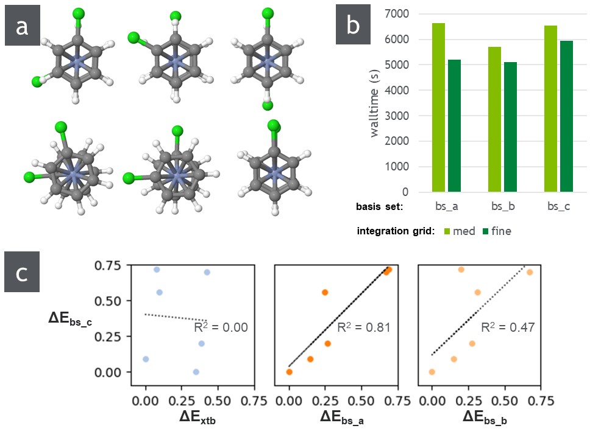
benchmarking DFT parameters for Cr complexes
doublet
potential side-product in chlorobenzene solvent
Use fine integration grid (faster and more accurate)
Basis sets:
bs_a = def2-SV(P) all atoms
bs_b = def2-SVP on Cr; def2-SV(P) all other atoms
bs_c = def2-SVP all atoms ← most accurate, moderate increase in calculation time

Slide 31
Haloarene solvents limits formation of inactive [Cr(arene)₂]+
Electron-poor aromatic solvents are proposed to enhance catalysis by limiting formation of inert [Cr(arene)]⁺
Bercaw and coworkers, ACS Catal. 2013, 3, 2582
w/ Al
DFT calculated reaction energies
X = | H | Cl | F
ΔG (w/ Al) | 0.5 | 9.4 | 11.0
ΔG (no Al) | tbd | tbd | tbd
no Al

Slide 32
Upcoming conferences
3750020 - Ethylene tetramerization: Mechanism and role of solvent
01:40pm - 02:00pm USA / Canada - Central - August 24, 2022 | Location: Virtual-only (Zoom)
Sibo Lin, Presenter; Mohamed Elanany; Dana Wong; Yagnaseni Ghosh; Brian Hanna
Division: [CATL] Division of Catalysis Science & Technology
Session Type: Oral - VirtualChromium diphosphinoamine catalysts are among the most successful for ethylene tetramerization to 1-octene, although inadvertent byproducts such as 1-hexene or polyethylene are also formed. To address this challenge, we have explored the mechanism of ethylene tetramerization catalysts with density functional theory. The roles of certain solvents on catalyst activity and product selectivity is supported by computational modelling and experimental catalytic testing.
*ACS Fall 2022
Aug 24, 2022 (Virtual)
(accepted for 20 minute presentation on ethylene tetramerization)
International Conference on Catalysis and Chemical Engineering
Oct 21-22, 2022 (Online)
2nd round abstract deadline Aug 15 2022
AIChE Fall 2022
Nov 13-18, 2022 (Phoenix)
(program already finalized)
*Gulf Chemistry Association 1st International Conference
Nov 15-17, 2022 (Bahrain)
Abstract submission deadline passed
International Conference on Catalysis and Chemical Engineering
Feb 20-22, 2023 (Las Vegas)
Abstract Deadline Aug 4 2022
Gordon Conference: Inorganic Reaction Mechanisms
March 5-10 (Galveston, TX)
ACS Spring 2023
March 26-30 (Indianapolis, IN)
>> North American Catalysis Society Meeting (NAM28)
June 18-23, 2023 (Providence, RI)
Abstracts due Nov 7, 2022
Gordon Conference: Organometallic Chemistry
July 9-14 (Newport, RI)
AIChE 2023
Nov 5-10, 2023 (Orlando, FL)

Slide 33
Ethylene Tetramerization Outline
1-octene purpose
1-octene technology (polymer fouling)
KFUPM results (PhCl), HTE results (PhCl, PhF), Bercaw thesis and patent (including oDCB, oDFB)
Previous mechanistic studies, just change Me to iPr?
Not so simple: many conformers
XTBDFT
General Mechanism
Effect of extra ligand on ethylene insertion
Effect of extra ligand on beta-hydride transfer (ethylene vs PhCl vs PhF)
Explains lower O1/H1 ratio with PhCl, same ratio with PhF
PhCl and PhF could act anti-fouling agent for unknown PE catalyst
Higher catalyst activity could simply be solubility related
Develop better solubility catalysts, preliminary results, patent pending

